Slide 1
Operating System UNIX & Linux
Programme – T.Y.BBA(CA)
Subject title - Operating System UNIX & Linux (Revised 2017 Pattern)
Subject code-4604 Semester - VI
Credit – 4
Unit 3: Introduction to the File System
By
Deepali Bhoskar

Slide 2
Introduction to the File System Pathnames, File system Mounting and unmounting, The organization of the File Tree, File Types, File Attributes, Access Control lists

Slide 3
Introduction to the File System
Unix file system is a logical method of organizing and storing large amounts of information in a way that makes it easy to manage.
A file is a smallest unit in which the information is stored.
Unix file system has several important features.
All data in Unix is organized into files.
All files are organized into directories.
These directories are organized into a tree-like structure called the file system.
Files in Unix System are organized into multi-level hierarchy structure known as a directory tree.
At the very top of the file system is a directory called “root” which is represented by a “/”.
All other files are “descendants” of root.

Slide 4
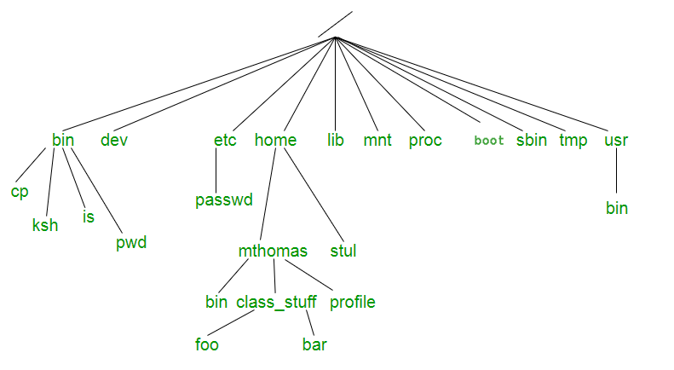
Introduction to the File System

Slide 5
Introduction to the File System
Directories or Files and their description –
/ : The slash / character alone denotes the root of the filesystem tree.
/bin : Stands for “binaries” and contains certain fundamental utilities, such as ls or cp, which are generally needed by all users.
/boot : Contains all the files that are required for successful booting process.
/dev : Stands for “devices”. Contains file representations of peripheral devices and pseudo-devices.
/etc : Contains system-wide configuration files and system databases. Originally also contained “dangerous maintenance utilities” such as init , but these have typically been moved to /sbin or elsewhere.
/home : Contains the home directories for the users.
/lib : Contains system libraries, and some critical files such as kernel modules or device drivers.
/media : Default mount point for removable devices, such as USB sticks, media players, etc.
/mnt : Stands for “mount”. Contains filesystem mount points. These are used, for example, if the system uses multiple hard disks or hard disk partitions. It is also often used for remote (network) filesystems, CD-ROM/DVD drives, and so on.
/proc : proc fs virtual filesystem showing information about processes as files.

Slide 6
Introduction to the File System
/root : The home directory for the super user “root” – that is, the system administrator. This account’s home directory is usually on the initial file system, and hence not in /home (which may be a mount point for another file system) in case specific maintenance needs to be performed, during which other file systems are not available. Such a case could occur, for example, if a hard disk drive suffers physical failures and cannot be properly mounted.
/tmp : A place for temporary files. Many systems clear this directory upon startup; it might have tmp fs mounted atop it, in which case its contents do not survive a reboot, or it might be explicitly cleared by a startup script at boot time.
/usr : Originally the directory holding user home directories ,its use has changed. It now holds executables , libraries, and shared resources that are not system critical, like the X Window System, KDE, Perl, etc. However, on some Unix systems, some user accounts may still have a home directory that is a direct subdirectory of /usr , such as the default as in Minix. (on modern systems, these user accounts are often related to server or system use, and not directly used by a person).
/usr/bin : This directory stores all binary programs distributed with the operating system not residing in /bin, /sbin or (rarely) /etc.
/usr/include : Stores the development headers used throughout the system. Header files are mostly used by the #include directive in C/C++ programming language.

Slide 7
Introduction to the File System
/usr/lib : Stores the required libraries and data files for programs stored within /usr or elsewhere.
/var : A short for “variable.” A place for files that may change often – especially in size, for example e-mail sent to users on the system, or process-ID lock files.
/var/log : Contains system log files.
/var/mail : The place where all the incoming mails are stored. Users (other than root) can access their own mail only. Often, this directory is a symbolic link to /var/spool/mail.
/var/spool : Spool directory. Contains print jobs, mail spools and other queued tasks.
/var/tmp : A place for temporary files which should be preserved between system reboots.

Slide 8
File System Pathnames
A Unix/Linux pathname is a text string made up of one or more names separated by forward slashes(/)
e.g. /etc/passwd, /var/log/auth.log, assignment02/check, etc.
A pathname is a path-of-names that indicates how to find something in the hierarchical file system tree.
Here are some examples of pathnames:
/home /etc/passwd /usr/bin/wc /var/log/ntpstats/loopstats
/home/abcd0001/CST8207-19F/Assignments/assignment02 assignment02/check ../../Assignments
A pathname is literally a “path of names” through the hierarchy. A pathname specifies how to traverse (navigate) the hierarchical directory names in the file system to reach some destination object.
The pathname text string will contain, in order, the directories you need to go through to arrive at the destination. To do this, the pathname text string lists one or more name components separated by forward slashes, e.g. /etc/passwd, /usr/bin/wc. This is why individual file and directory names cannot themselves contain slashes – slashes are used to separate the names in pathname text strings.
Slashes separate the names in pathname text strings.

Slide 9
Introduction to the File System
Destination object may be file, directory, or other
The destination object identified by the name at the far right end of a pathname text string might be a file, a directory, or some other thing such as system memory, a disk partition, or a terminal device. (Unix/Linux also uses the file system to name many things that are not ordinary files or directories.)
In a valid pathname, all the names to the left of the name at the far right end must be directories (or symbolic links to directories). If foo/bar/x is a valid pathname, then foo and bar must be directories.
3.2 A single name doesn’t need any slashes as separators
A pathname with only one name component doesn’t need to have any slashes to separate it from other name components, e.g. resume, cal.txt, dir.exe are valid names and don’t need any slashes.
Slashes are only used to separate name components in a pathname; an individual name component can never itself contain a slash. Slashes are never part of a name component; they separate the names in a pathname.
A Linux pathname text string has an overall limit of 4,096 characters including all the individual names and all the separating slashes. Older Unix systems have a smaller limit.

Slide 10
File system Mounting and unmounting
The Linux file system forms a hierarchical structure tree rooted at /.
This root / is mounted during startup, other file systems remain unusable until they are mounted at a mount point. For access to a file system, it needs to be mounted.
Example: A case on point where we would need mounting is whereby assuming we are running a very popular web service on a 500 GB HDD but data grows very fast and we need to increase the storage space, mounting enables us to mount a new larger-capacity storage device at any point in a directory while maintaining the same file structure.
Mounting and unmounting file systems requires root privileges on the system and the existence of the directory in which we will mount the file system in the case of mounting
Mounting:-
This is the process of associating a file system to a storage device. In Linux the mount command is used so as to attach a file system to the file system hierarchy. When mounting we provide information such as files system type, file system and the mount point.
By mounting a file system onto the file hierarchy, a file system becomes a subtree of the hierarchy and thus it is possible to navigate from the rest for the file hierarchy.

Slide 11
File system Mounting and unmounting
Mounting can also be done from one system to another by use of a networked file system e.g NFS or AFS.
We can also opt to create a file in another existing file system and format it as a file system and mount it e.g downloading an ISO file and mounting it rather than copying it to another media.
A mount point is a directory created as part of the file system e.g the root file system is mounted in the / directory.
Mounting of file systems happens during startup and it is managed by the /etc/fstab (file system table) configuration file.
This file will have a list of all file systems, their selected mount points and other file system specific options.
To view the fstab file type cat /etc/fstab command.
From the output we can see columns such as,
Filesystem: we can either specifies the file system by UUID(universal unique identifier) or a disk label.
Mountpoint: is the directory on the file system we shall use to access stored data on the disk.
Type: This specifies the type of the file system.
Options: Here we can specify options for tuning a mount.
Dump: We can either enable or disable dumping on the system.
Pass num: Here we set the order user so that fsck can check the file system.

Slide 12
File system Mounting and unmounting
We can view all mounted file systems by using the mount command.
$mount
Unmounting:-
All file systems are normally unmounted when the system powers down and any cached data stored in memory is flushed to the device.
Unmounting can be done manually e.g when removing writable media such as USBs. The unmount command is used for this operation as follows,
$unmount [directory]
Or
$unmounts [device]
After unmounting files in the directory used as mount points, the hidden files if they existed will become visible again.
Errors can occur when we try to unmount a file system while there are processes with its files open.

Slide 13
The organization of the File Tree
All of the files in the UNIX file system are organized into a multi-leveled hierarchy called a directory tree.
A family tree is an example of a hierarchical structure that represents how the UNIX file system is organized. The UNIX file system might also be envisioned as an inverted tree or the root system of plant.
At the very top of the file system is single directory called "root" which is represented by a / (slash). All other files are "descendents" of root.
The number of levels is largely arbitrary, although most UNIX systems share some organizational similarities. The "standard" UNIX file system is discussed later.
Example

Slide 14
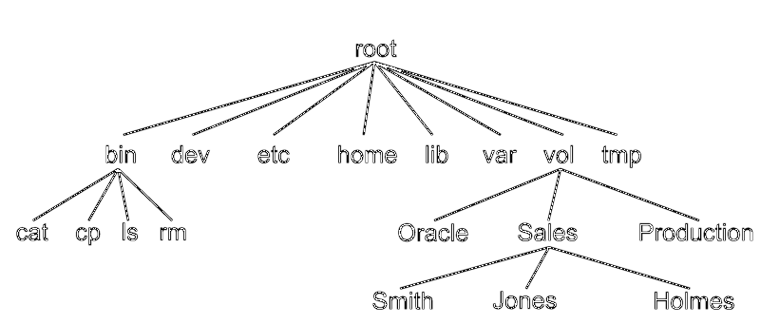
The organization of the File Tree

Slide 15
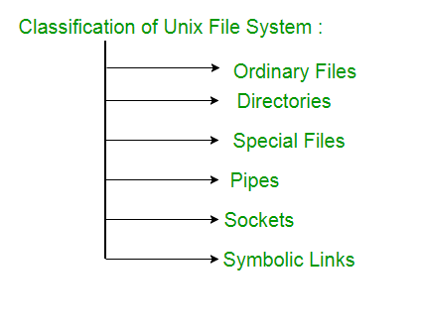
FILE types
The UNIX files system contains several different types of files :

Slide 16
FILE types
The UNIX files system contains several different types of files :
1. Ordinary files –
An ordinary file is a file on the system that contains data, text, or program instructions.
Used to store your information, such as some text you have written or an image you have drawn. This is the type of file that you usually work with.
Always located within/under a directory file.
Do not contain other files.
In long-format output of ls -l, this type of file is specified by the “-” symbol.

Slide 17
FILE types
2. Directories –
Directories store both special and ordinary files. For users familiar with Windows or Mac OS, UNIX directories are equivalent to folders. A directory file contains an entry for every file and subdirectory that it houses. If you have 10 files in a directory, there will be 10 entries in the directory. Each entry has two components.
(1) The Filename
(2) A unique identification number for the file or directory (called the inode number)
Branching points in the hierarchical tree.
Used to organize groups of files.
May contain ordinary files, special files or other directories.
Never contain “real” information which you would work with (such as text). Basically, just used for organizing files.
All files are descendants of the root directory, ( named / ) located at the top of the tree.
In long-format output of ls –l , this type of file is specified by the “d” symbol. 3.

Slide 18
FILE types
Special Files –
Used to represent a real physical device such as a printer, tape drive or terminal, used for Input/Output (I/O) operations. Device or special files are used for device Input/Output(I/O) on UNIX and Linux systems. They appear in a file system just like an ordinary file or a directory. On UNIX systems there are two flavors of special files for each device, character special files and block special files :
When a character special file is used for device Input/Output(I/O), data is transferred one character at a time. This type of access is called raw device access.
When a block special file is used for device Input/Output(I/O), data is transferred in large fixed-size blocks. This type of access is called block device access.
For terminal devices, it’s one character at a time. For disk devices though, raw access means reading or writing in whole chunks of data – blocks, which are native to your disk.
In long-format output of ls -l, character special files are marked by the “c” symbol.
In long-format output of ls -l, block special files are marked by the “b” symbol.

Slide 19
FILE types
4. Pipes –
UNIX allows you to link commands together using a pipe. The pipe acts a temporary file which only exists to hold data from one command until it is read by another.
A Unix pipe provides a one-way flow of data.The output or result of the first command sequence is used as the input to the second command sequence.
To make a pipe, put a vertical bar (|) on the command line between two commands.
For example: who | wc -l In long-format output of ls –l , named pipes are marked by the “p” symbol.
5. Sockets – A Unix socket (or Inter-process communication socket) is a special file which allows for advanced inter-process communication.
A Unix Socket is used in a client-server application framework. In essence, it is a stream of data, very similar to network stream (and network sockets), but all the transactions are local to the filesystem.
In long-format output of ls -l, Unix sockets are marked by “s” symbol.

Slide 20
FILE types
6. Symbolic Link –
Symbolic link is used for referencing some other file of the file system. Symbolic link is also known as Soft link.
It contains a text form of the path to the file it references.
To an end user, symbolic link will appear to have its own name, but when you try reading or writing data to this file, it will instead reference these operations to the file it points to.
If we delete the soft link itself , the data file would still be there.
If we delete the source file or move it to a different location, symbolic file will not function properly. In long-format output of ls –l , Symbolic link are marked by the “l” symbol (that’s a lower case L).

Slide 21
Access Control lists(ACL)
Why we need ACLs
Every file on any UNIX file system will have an owner/group and set of permissions. Imagine a case when multiple users need access to the same file and the users are from different groups. The file access control lists (FACLs) or simply ACLs are the list of additional users/groups and their permission to the file.
It is very easy to know when a file has a attached ACL to it. ls -l command would produce a output as show below.
# ls -l -rw-r--r-+ 1 root root 0 Sep 19 14:41 file
Note the + sign at the end of the permissions. This confirms that the file has an ACL attached to it.

Slide 22
Access Control lists(ACL)
To display details ACL information of a file use the getfacl command.
# getfacl /tmp/test
# file: test
# owner: root
# group: root
user::rw-
user:john:rw-
user:sam:rwx
group::r-- mask::rwx
other:---
Notice the 3 different user: lines. The first line lists the standard file permissions of the owner of the file. The 2

